Slide 1

RecoveryPro –
New Issues, Examiner Focus, and Cybersecurity
with Bill Ashland

Slide 2

Recovery Pro – New Issues, Examiner Focus, and Cybersecurity
Topics
What’s on Your radar?
Current Challenges?
Questions You Want Answered?
New/Updated Content:
  BCP
  Incident Management
  Cyber Incident Response
Monday, October 20th, 2025

Slide 3

Recovery Pro – New Issues, Examiner Focus, and Cybersecurity
What’s on Your Radar?
Auditor/regulator feedback received?
Threats that are top of mind currently?
Program objectives/focus areas?
  The current political climate
  AI
  Social Engineering (deepfakes, voice copying)
Monday, October 20th, 2025

Slide 4
Recovery Pro – New Issues, Examiner Focus, and Cybersecurity
Current Challenges?
Program challenges?
RecoveryPro specific areas of need?
  Pictures being difficult ☺
Monday, October 20th, 2025

Slide 5
Recovery Pro – New Issues, Examiner Focus, and Cybersecurity
Questions You Want Answered?
Business Continuity Questions?
Recovery Pro Questions?
  Key fobs MFA tokens for vendor access in a facility event – How to handle?
Monday, October 20th, 2025

Slide 6
Recovery Pro – New Issues, Examiner Focus, and Cybersecurity
New/Updated Content - BCP
Planning Assumptions:
In today's technology dependent world, virtually every team member requires baseline computing and communications equipment and applications to effectively function. As such:
Every employee is assumed to need a computer(laptop or desktop) with network connectivity and Microsoft 365 applications (including MS Outlook)
Every employee is assumed to need a telephony device (desktop handset, softphone, or handheld device) in order to make and receive calls internally (with staff) and externally (with vendors and service providers, and others)
Monday, October 20th, 2025

Slide 7
Recovery Pro – New Issues, Examiner Focus, and Cybersecurity
New/Updated Content - BCP
Related Documentation:
Other documentation and resources are in place to support the Response and Recovery efforts of [[CUname]]. These include:
Event/Incident Response and Incident Management -
  [[CUname]] Incident Management Procedure
  [[CUname]] Cyber incident Response
  Event/Incident Log
  (Add any other related documentation here, such as evacuation/shelter in place plans)
Systems Recovery –
  (Add any Systems Recovery documentation here, if applicable)
Monday, October 20th, 2025

Slide 8
Recovery Pro – New Issues, Examiner Focus, and Cybersecurity
New/Updated Content – Incident Management
Business Continuity Order of Succession:
If the Decision-Making Authority is unavailable, define order of succession for BCP purposes:
  1. CEO
  2. COO
  3. Director of Member Experience
  4. …
  5. …
Monday, October 20th, 2025

Slide 9
Recovery Pro – New Issues, Examiner Focus, and Cybersecurity
New/Updated Content – Incident Management
Incident Management Team Identified:
Decision-Making Authority
Management Team
Who else?
  Technical staff,
  Marketing (for communications) ,
  Facilities,
  Others (by Role)
Monday, October 20th, 2025

Slide 10
Recovery Pro – New Issues, Examiner Focus, and Cybersecurity
New/Updated Content – Incident Management
Emergency Powers:
If we are in a crisis/BCP event, what operational changes are implemented at the credit union and/or emergency powers granted to the Incident Management Team/Team Leader? Typically, these include:
Purchase Limits:
Cash Limits:
Personnel Issues:
Contractual Authority:
Others?
Monday, October 20th, 2025

Slide 11
Recovery Pro – New Issues, Examiner Focus, and Cybersecurity
New/Updated Content – Incident Management
Reporting and notification:
  NCUA Catastrophic Act Reporting –
    Federally insured credit unions are required to notify regional NCUA director within 5 business days of any catastrophic act that occurs at its office(s).
    A catastrophic act is any disaster resulting in destruction or damage to the credit union or an interruption in vital member services projected to last more than 2 consecutive business days.
    Vital members services include account inquiries, share withdrawals and deposits, and loan payments and disbursements.
    Afterwards, the credit union must prepare & file a record of the incident at its main office (Where, when, loss amount, contributing deficiencies, & corrective actions).
Monday, October 20th, 2025

Slide 12
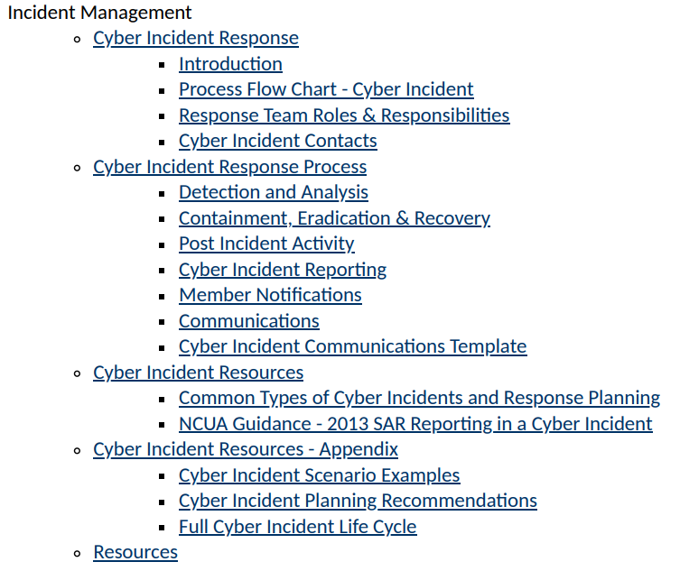
Recovery Pro – New Issues, Examiner Focus, and Cybersecurity
New/Updated Content – Cyber Incident Response
NEW Content: (Within Incident Management)
1600: Cyber Incident Response
1650: Cyber Incident Response Process
1660: Cyber Incident Resources
1670: Cyber Incident Resources - Appendix
Monday, October 20th, 2025

Slide 13
Recovery Pro – New Issues, Examiner Focus, and Cybersecurity
New/Updated Content – Cyber Incident Response
Reporting and notification:
  Cyber Incident Reporting –
    Federally insured credit unions that experience a reportable cyber incident, required to notify NCUA ASAP and no later than 72 after it reasonably believes it happened.
    A reportable cyber incident is any substantial cyber incident that leads to:
      A data compromise or (due to a data compromise) network or member information system impact, disruption of vital member services, or impacts the safety and resiliency of operational/systems and processes.
      A disruption (business operations, vital member services, member information systems) due to a cyberattack or exploitation of vulnerabilities.
      Either of the above if facilitated through or caused by a third-party provider.
Monday, October 20th, 2025

Slide 14
Recovery Pro – New Issues, Examiner Focus, and Cybersecurity
New/Updated Content – Cyber Incident Response
Reporting and notification:
  Cyber Incident Reporting –
    A reportable cyber incident doe not include any event where the cyber incident was performed in good faith in response to the owner/operators of the system.
  Definitions –
    Compromise – unauthorized disclosure/modification/substitution/use of data/system/device process
    Confidentiality – preserving restrictions on personal/proprietary information access/disclosure
    Cyber-incident – occurrence that unlawfully actually or imminently jeopardizes an information system/data
    Cyber attack – an attack via cyberspace, to disrupt/disable/destroy/control/steal system or data
    Disruption – unplanned event that causes a system to be inoperable for a period of time
    Integrity – guarding against improper information modification/destruction, ensuring authenticity
    Sensitive data – data that could, by itself or in combination with other data, be used to cause harm
Monday, October 20th, 2025

Slide 15
Recovery Pro – New Issues, Examiner Focus, and Cybersecurity
New/Updated Content – Cyber Incident Response
Reporting and notification:
  How to report –
    NEW NCUA Online Cyber Incident Reporting System
    Call the NCUA at 1-833-CYBERCU (1-833-292-3728) and leave a voicemail; or,
    Use the National Credit Union Administration Secure Email Message Center(opens new window) to send a secure email to cybercu@ncua.gov.
  What to report –
    Reporter Name, Title, and callback number
    Charter number (exclude leading zeroes) and credit union name
    Date and Time you reasonably believe a reportable cyber incident took place
    General description of the cyber incident: services impacted, if (not what) sensitive data or member information was compromised, operational impacts.
Monday, October 20th, 2025

Slide 16
Recovery Pro – New Issues, Examiner Focus, and Cybersecurity
New/Updated Content – Cyber Incident Response
Reporting and notification:
  What NOT to include –
    Sensitive personally identifiable information
    Indicators of compromise
    Specific vulnerabilities
    Email attachments
Monday, October 20th, 2025

Slide 17
Recovery Pro – New Issues, Examiner Focus, and Cybersecurity
New/Updated Content – Cyber Incident Response
Member Notification:
  Standard for providing notice –
    Investigation determines that misuse of member information occurred/possible
    Notification can be delayed (at credit union discretion) at law enforcement request (in writing)
  Sensitive member information –
    Information most susceptible to misuse/identity theft (names, addresses, telephone numbers, SSN, DL numbers, account numbers, credit/debit card numbers, PINs/passwords)
  Affected members –
    If precise impact is known, can limit notification to those impacted, if impact involves a group of member data files, but specific members cannot be identified, must notify the entire group.
Monday, October 20th, 2025

Slide 18
Recovery Pro – New Issues, Examiner Focus, and Cybersecurity
New/Updated Content – Cyber Incident Response
Member Notification:
  Content of member notices –
    What happened and types of member data compromised
    What the credit union has done to protect from further compromise
    A Telephone number to call for information/assistance
    Reminder to remain vigilant (next 12-24 months) and report any suspected identity theft
    When appropriate, include:
      Recommendation to review statements and report suspicious activity
      Description of fraud alerts and how to place them on credit reports
      Recommendation to periodically obtain and check credit reports and have fraud removed
      How to obtain a free credit report
      FTC guidance on identity theft prevention & reporting, website/contact info (www.ftc.gov) (202) 326-2222.
Monday, October 20th, 2025

Slide 19
Recovery Pro – New Issues, Examiner Focus, and Cybersecurity
New/Updated Content – Cyber Incident Response
Member Notification:
  Credit bureau notification –
    NCUA advises credit unions to notify credit reporting agencies before sending notices to large numbers of members that include contact information for the credit reporting agencies.
  Delivery of member notices –
    Can be sent in any many designed to ensure that a member can reasonably expected to receive it, including:
      Telephone
      Mail
      Electronic mail (for members who have agreed to receive notifications electronically)
Monday, October 20th, 2025

Slide 20
Recovery Pro – New Issues, Examiner Focus, and Cybersecurity
New/Updated Content – Cyber Incident Response
NCUA Guidance - SAR Reporting in a Cyber Incident :
  Suspicious Activity Report – Cyber Incident
  From FINCEN advisory letter FIN-2016-A005
  https://www.fincen.gov/resources/advisories/fincen-advisory-fin-2016-a005
    “A financial institution is required to report a suspicious transactions conducted or attempted by, at, or through the institution that involves or aggregates to $5,000 or more in funds or other assets. If a financial institution knows, suspects, or has reason to suspect that a cyber-event was intended, in whole or in part, to conduct, facilitate, or affect a transaction or a series of transactions, it should be considered part of an attempt to conduct a suspicious transaction or series of transactions. Cyber-events targeting financial institutions that could affect a transaction or series of transactions would be reportable as suspicious transactions because they are unauthorized, relevant to a possible violation of law or regulation, and regularly involve efforts to acquire funds through illegal activities.”
Monday, October 20th, 2025

Slide 21
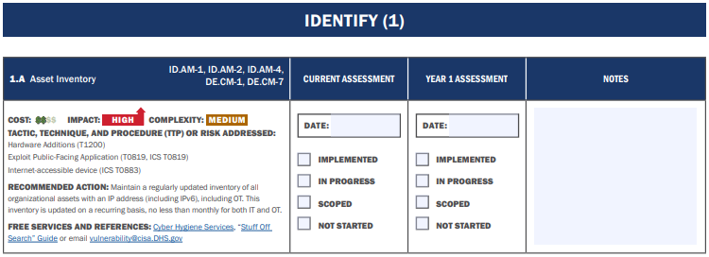
Recovery Pro – New Issues, Examiner Focus, and Cybersecurity
New/Updated Content – Cyber Incident Response
Appendix – Section 1673 - Full Cyber Incident Life Cycle – Preparation Mechanisms:
Out: NCUA ACET
In: CISA Cyber Information Security Awareness – cisa_cpg_checklist_v1.0.1_final.pdf
Monday, October 20th, 2025

Slide 22

Recovery Pro – New Issues, Examiner Focus, and Cybersecurity
Questions?
Contact information:
Bill Ashland
AVP, Business Continuity
Synergent
washland@synergentcorp.com
Monday, October 20th, 2025

